Slide 1
Machine Learning Approaches to Drug Sensitivity Prediction
CSCI 5523 Fall 2020 Final Project
Instructor: Vipin Kumar
Group Member: Yu Fang, Yu Han, Yixuan Wang, Xianjian Xie, Xiang Zhang

Slide 2
Background
NCI-DREAM project
46 cancer cell lines (samples)
Gene expression profiles for 18,632 genes (features)
Response from 5 different drugs: Everolimus, Disulfiram, Methylglyoxol, Mebendazole, 4-HC (target)
Challenge
High-dimensional feature space
Small sample size

Slide 3
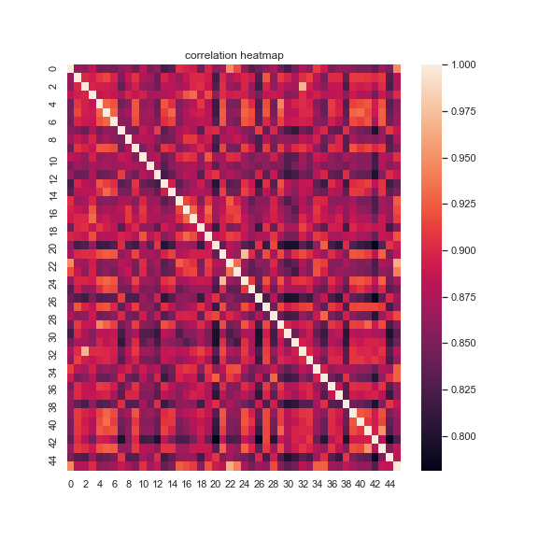
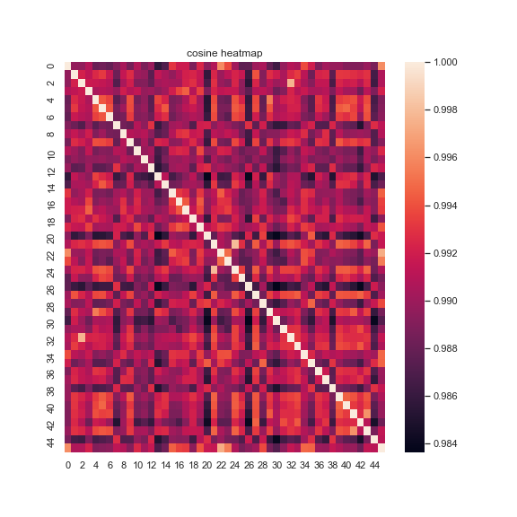
Dataset Analysis: Heatmap of 46 cancer cell lines
Correlation
Cosine

Slide 4
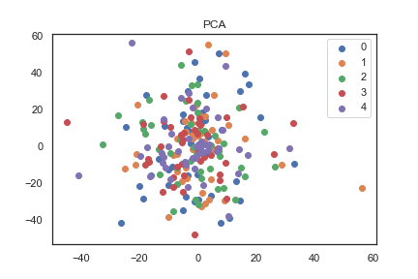
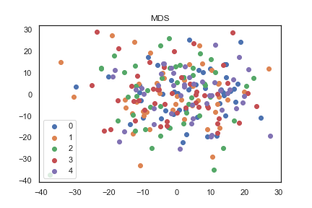
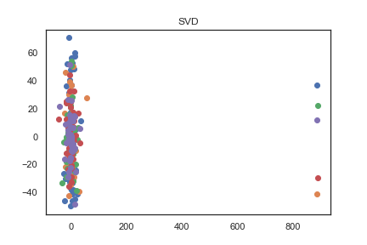
Dataset Analysis: Dimension Reduction
PCA MDS SVD
Visualization by plotting the first 5 components
Principal Component Analysis
Multidimensional Scaling
Singular Value Decomposition

Slide 5
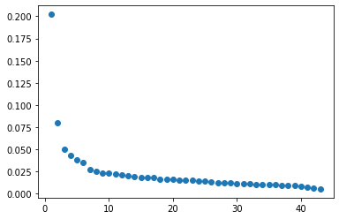
Dimension Reduction - PCA
Explained variance ratio 99% - more than 40 components
55.0% variance can be explained by 10 components

Slide 6
Cross Validation - Leave-one-out
n is the number of total record
Divide the data into k=n subsets
Testing set: 1 subset
Training set: other k-1 subsets

Slide 7
Methods: ML models integrated with dimensional reduction, kernel methods, and regularization
Sparse Linear Regression
Linear Regression: use features after dimension reduction
Lasso/Ridge/Elastic Net: apply regularization
Logistic Regression
Use features after dimension reduction
Support Vector Machine
Use features after (z-score) standardization

Slide 8
Methods (cont.)
Decision Trees
Test different bounds for maximal depth and number of features
Random Forest
Test different bounds for maximal depth and number of features
K-Nearest Neighbors
Use features after (z-score) standardization
Neural Networks
Use features after (z-score) standardization
L2 regularization

Slide 9
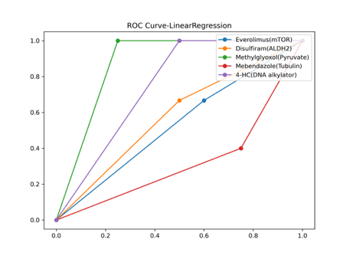
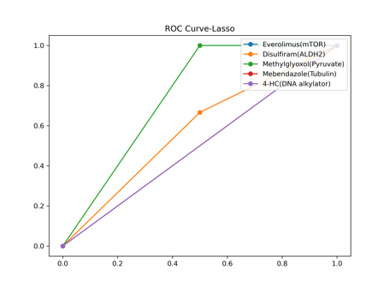

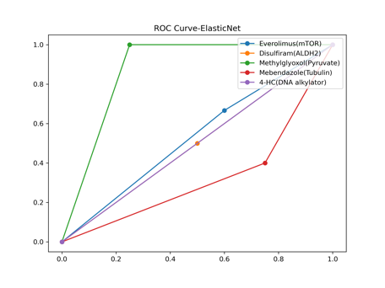
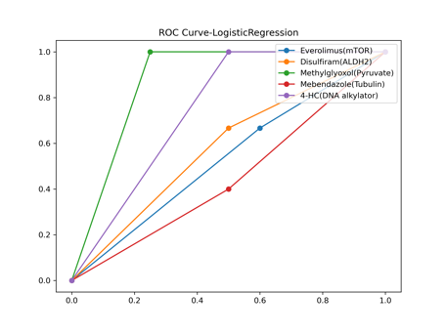
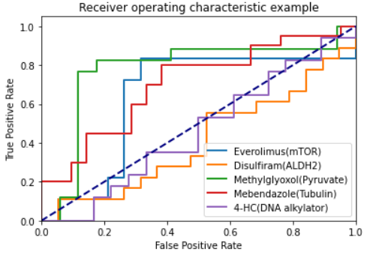
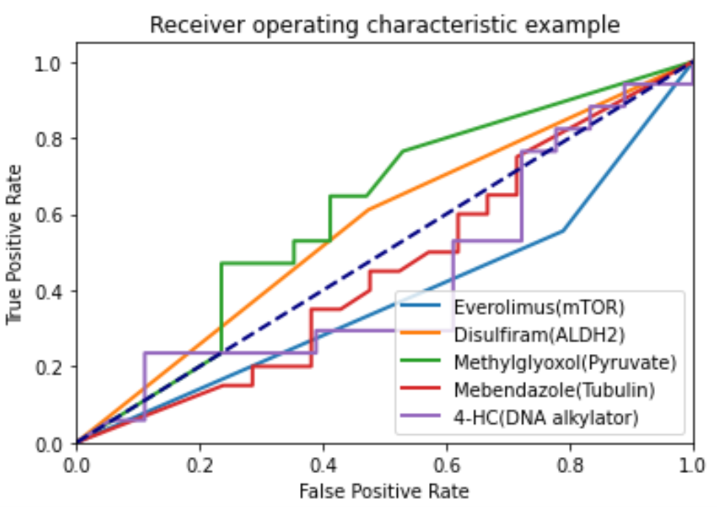
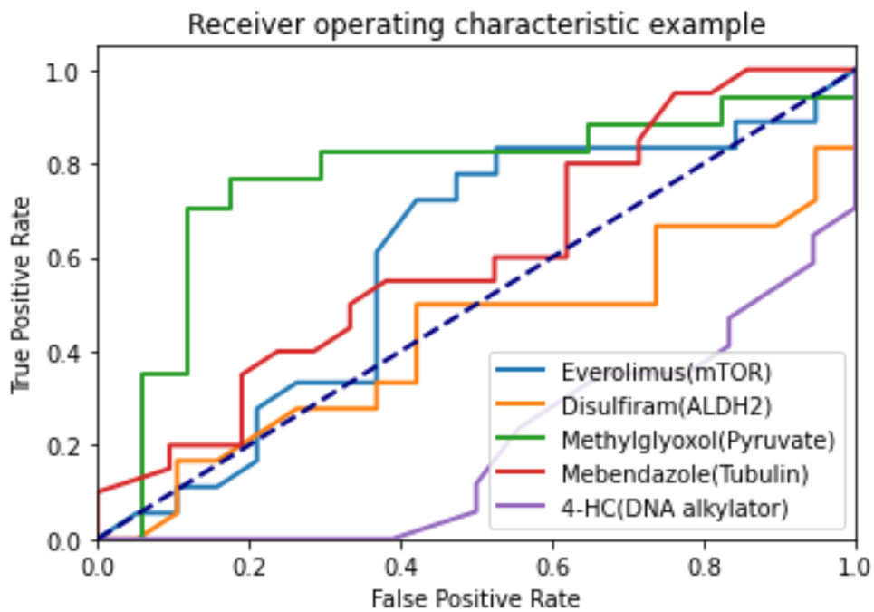
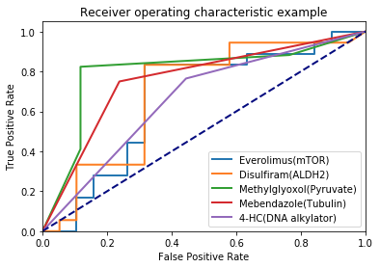
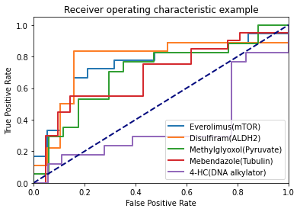
Results: ROC curve for 5 drugs from the optimal models
Linear Regression | Lasso | Ridge | Elastic Net | Logistic Regression
SVM | Decision Trees | Random Forest | KNN | Neural Networks

Slide 10
Results: Accuracy for 5 drugs from the optimal models
 | Linear Regression | Lasso Regression | Ridge Regression | Elastic Net | Logistic Regression | SVM | Decision Trees | Random Forest | KNN | Neural Networks
Drug 1 | 0.5 | 0.375 | 0.5 | 0.5 | 0.5 | 0.757 | 0.54 | 0.59 | 0.76 | 0.76
Drug 2 | 0.625 | 0.625 | 0.625 | 0.5 | 0.625 | 0.594 | 0.48 | 0.59 | 0.76 | 0.78
Drug 3 | 0.857 | 0.714 | 0.857 | 0.857 | 0.857 | 0.824 | 0.56 | 0.74 | 0.85 | 0.71
Drug 4 | 0.333 | 0.444 | 0.333 | 0.333 | 0.444 | 0.634 | 0.44 | 0.59 | 0.76 | 0.59
Drug 5 | 0.714 | 0.429 | 0.714 | 0.429 | 0.714 | 0.4 | 0.63 | 0.34 | 0.66 | 0.37

Slide 11
Conclusion
Applied different machine learning techniques to predict drug sensitivity for 5 different drugs across 46 cell line
Dimension reduction techniques or regularization help improve the models’ performance
Each machine learning technique performs differently on each task
Some standards are harder for training and testing

